Slide 1
EECE5698
Parallel Processing for Data Analytics
Lecture 0: Course Outline & Syllabus

Slide 2
Artificial Intelligence Winters (1960,1970,1980)
Research in the
60s: Machine Translation
70s: Speech Recognition, Human to Machine Interfaces
80s: Expert Systems
ALPAC Report, 1966
SUR program shutdown, 1974 Lighthill report, 1973
Collapse of LISP Market, 1987
Notes:
Automatic Language Processing Advisory Committee
Speech Understanding Research

Slide 3
What Winter?
Amazon Echo
Google Home
Siri
…

Slide 4
What Winter?
Companies launching self-driving cars:
Google
Uber
Tesla
Amazon
BMW, Chrysler, GM,…

Slide 5
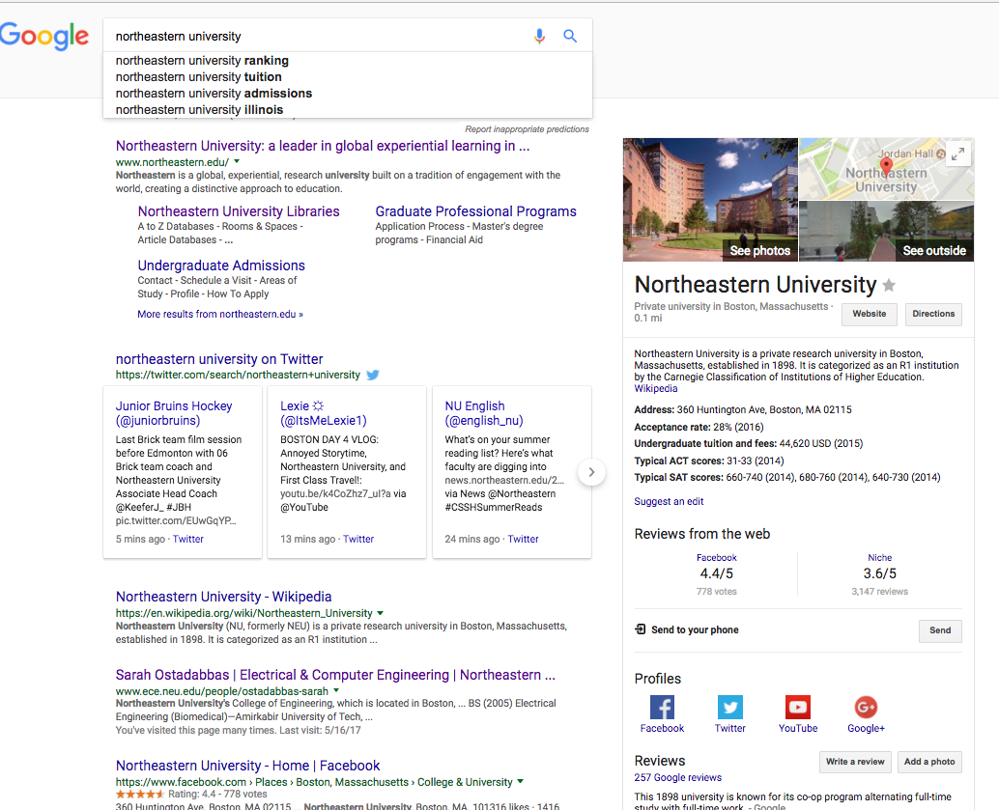
What Winter?

Slide 6
What Winter?
Q: How did we get to today's spring?
A: Big Data!

Slide 7
Big Data
+
Massive Computational Power
Massive Datasets

Slide 8



1st ingredient: massive computational power

Slide 9
Google's Beginnings
"…as of September 2000.
Google, now located in Mountain View, operated 5000 PCs for searching and web crawling"

Slide 10
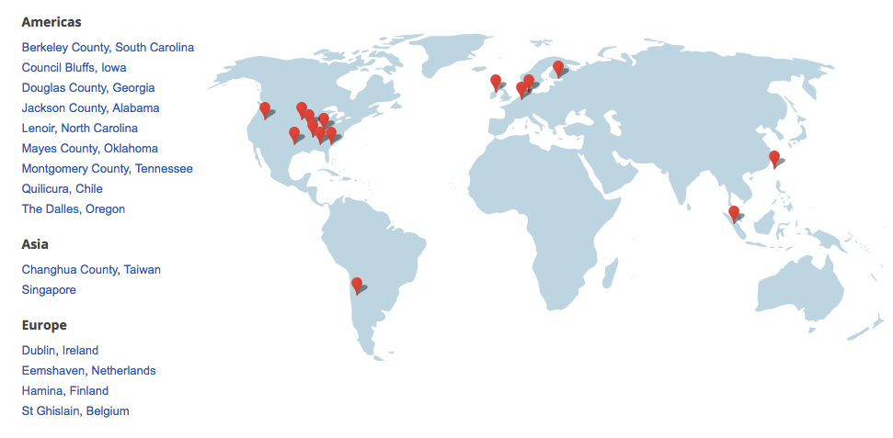
Data Centers Today
15 Data centers (9 in US)
2.5M servers in 2016
Notes:
15 datacenters, several football fields, 9 Locations in US,

Slide 11
Dealing with Massive Computational Tasks
Built using commodity, low-cost hardware
Execute "embarrassingly parallel" operations
Automated tools to access, process, and analyze collected data

Slide 12

2nd ingredient: Massive Datasets!
What do each of these companies know about you?

Slide 13












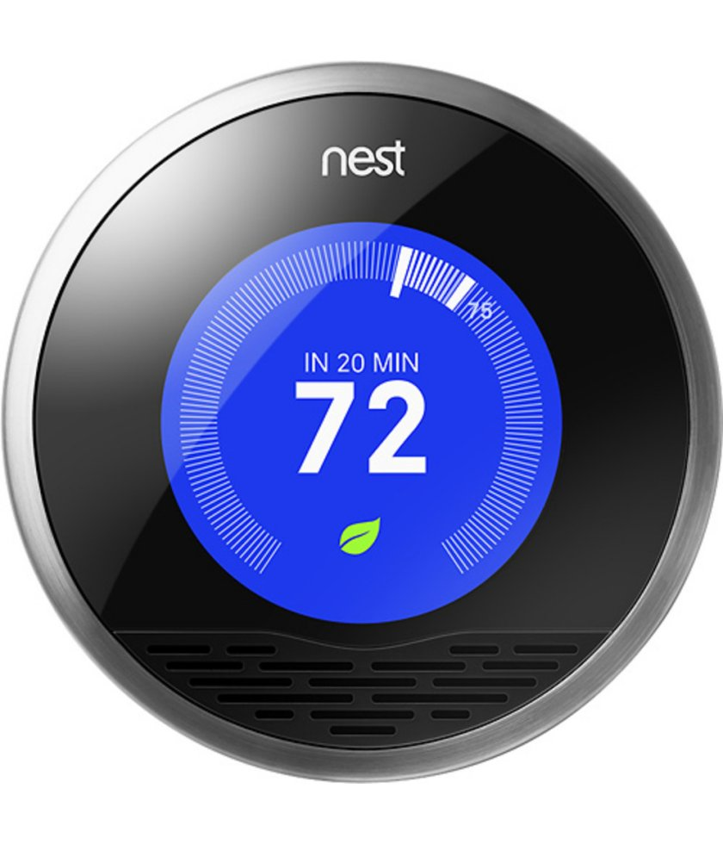
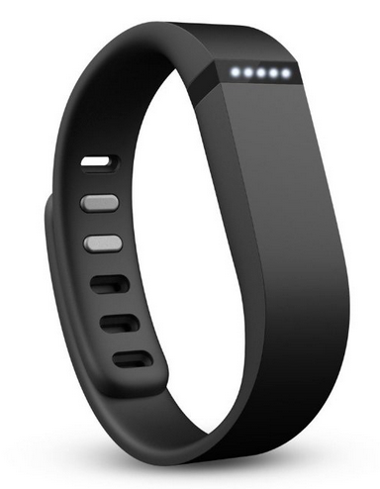
The Quantity & Type of Information is Ever-Increasing!
web graph
mobile platforms
explicit user feedback
audio streaming
cloud computing
1994
1997
2003
2005
2006
2007
2010
2013
2015
video streaming
speech
product purchases
ad clicks
social networks
internet of things

Slide 14
Massive Data + Massive Computational Power…
…has led to breakthroughs in a broad variety of fields
Image processing
Speech recognition
Natural language processing
…
Images sampled randomly from 10 million Youtube videos
DNN trained over 1000 machines of 16 cores each

Slide 15
Some Questions/Challenges?
How does one use 1000s of machines simultaneously?
How does one deal with TBytes of data?
Why does having more data even help?
…by the end of the class, we should be able to answer these questions!!

Slide 16
Data Analytics as a Profession
http://drewconway.com/zia/2013/3/26/the-data-science-venn-diagram

Slide 17
What does EECE5698 cover?
Parallel Programming with Spark
Convex Optimization fundamentals
How do I minimize a function?
Regression and Classification
How do I predict whether a user will click on an ad?
How can I be confident that my prediction is correct?
Advanced Topics
Matrix Factorization
DNNs
…
I
N
P
A
R
A
L
L
E
L

Slide 18





Course Overview (see also Course Syllabus)
Regression, Classification
Regularization, Cross Validation
…
Blood Pressure
Age
Weight
Statistics &
Machine Learning
Gender
40K
19ys
3.1
55K
34ys
1.2
…
90K
24ys
2.5
Descent Methods
Gradient Descent
Newton Method
…
Convex Optimization
map reduce reduceByKey join …
+
Parallel Processing

Slide 19
What is Spark?
A general engine for large-scale data processing
Extensively used in the industry
Seamlessly integrates with Python, itself a powerful general-purpose programming language
Very easy to parallelize your programs, and learn map reduce concepts
Class will be self-contained: you can do with Spark+Python everything you learn here, and much more!
+

Slide 20
By the end of the class you will…
…be confident in programming in Python and Spark
…have mastered map/reduce concepts
…understand the basic ML/statistics pipeline, i.e., how to
Train a model
Identify important features
Validate your model's performance
…understand why you are doing these steps
…learn how do these steps in parallel over many machines, processing massive datasets!

Slide 21
This Course is Not…
…a Machine Learning class:
There will be a math+statistics component, but we will focus on parallelism and simple methods
…a programming-only class:
There will be math + stats: we should understand what we are doing, and why
…a "learn how to use toolboxes and libraries" class:
You will program everything from scratch (i.e., learn how to build your own toolbox)

Slide 22
Reference Textbooks
Karau, H., Konwinski, A., Wendell, P. and Zaharia, M., 2015. Learning Spark: Lightning-Fast Big Data Analysis. Available online at NEU library: http://onesearch.northeastern.edu/NU:NEU_ALMA51225375080001401&tabs=viewOnlineTab
Boyd, S., & Vandenberghe, L. (2004). Convex Optimization. Cambridge University Press. Available online: http://stanford.edu/~boyd/cvxbook/
Friedman, J., Hastie, T., and Tibshirani, R.. The Elements of Statistical Learning. Springer. Available online: https://statweb.stanford.edu/~tibs/ElemStatLearn/
We will mostly rely on course slides + lecture notes.

Slide 23
Online Resources
Blackboard Website: https://blackboard.neu.edu/webapps/blackboard/execute/modulepage/view?course_id=_2504287_1&cmp_tab_id=_356604_1&editMode=true&mode=cpview
Discovery Cluster Wiki: https://github.com/neu-spiral/Discovery-Cluster
Piazza: https://piazza.com/northeastern/fall2017/eece5698/home

Slide 24
Logistics
Grading Scheme
Homework: 40%
Midterm exam: 30%
Course project: 30%
Consult the Course Calendar for due dates.
Homework
4 programming assignments
all will involve Spark
Submit code and typewritten report
Should be executed on the Discovery cluster
Instructor
Stratis Ioannidis, ioannidis@ece.neu.edu
Office hours: T2-4pm, 414ISEC
TA: Edward Scott
Use Piazza to ask questions!!

Slide 25
Class Project
30% of final grade
In teams of 2 people
Need to:
Form teams by Friday, Oct 6th
Submit 1-page proposal by Friday, Oct 27th (not graded)
Submit report + present results during exam week (date TBD)
Project Details
Does not need to be in Spark (though it certainly can be)
Must involve parallelism
Must involve analyzing an interesting, large dataset
Must include a validation analysis
Must demonstrate that parallelism helped
Must clearly state what each participant did

Slide 26
Discovery Cluster
Managed by NEU Information Technology Services
Housed at the Massachusetts Green High Performance Computing Center (MGHPCC)
300 compute nodes, 20K cores
Getting started: see Programming Resources on Blackboard to find out more

Slide 27
Discovery Cluster To-Do List
1. Get an account ASAP!
2. Create a .bashrc file loading all modules you will need.
3. Familiarize yourself with how to reserve an interactive node
Instructions can be found in Programming Resources on Blackboard, we will do a demo of 2. and 3. in class

Slide 28
Coming Up Next:
Python Review
Introduction to Spark
Deep-dive into Spark Fundamentals
Demos on how to connect to the Discovery cluster and run python and spark

